Slide 1

The New Age of Digital Finance

Slide 2
How Do You Know You Are In the Middle of a Revolution?

Slide 3
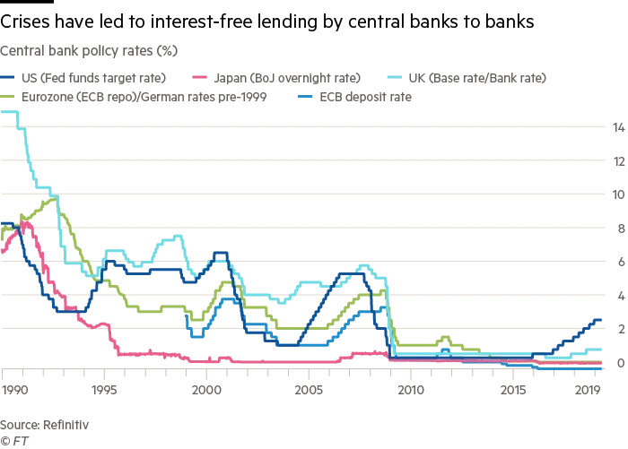
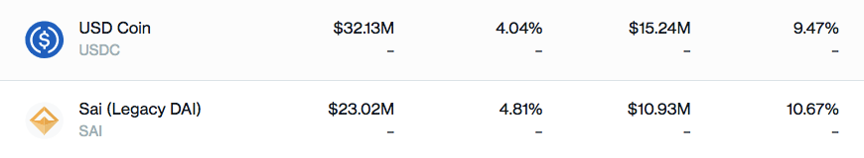
Giving 5% Interest in a 0% Environment

Slide 4
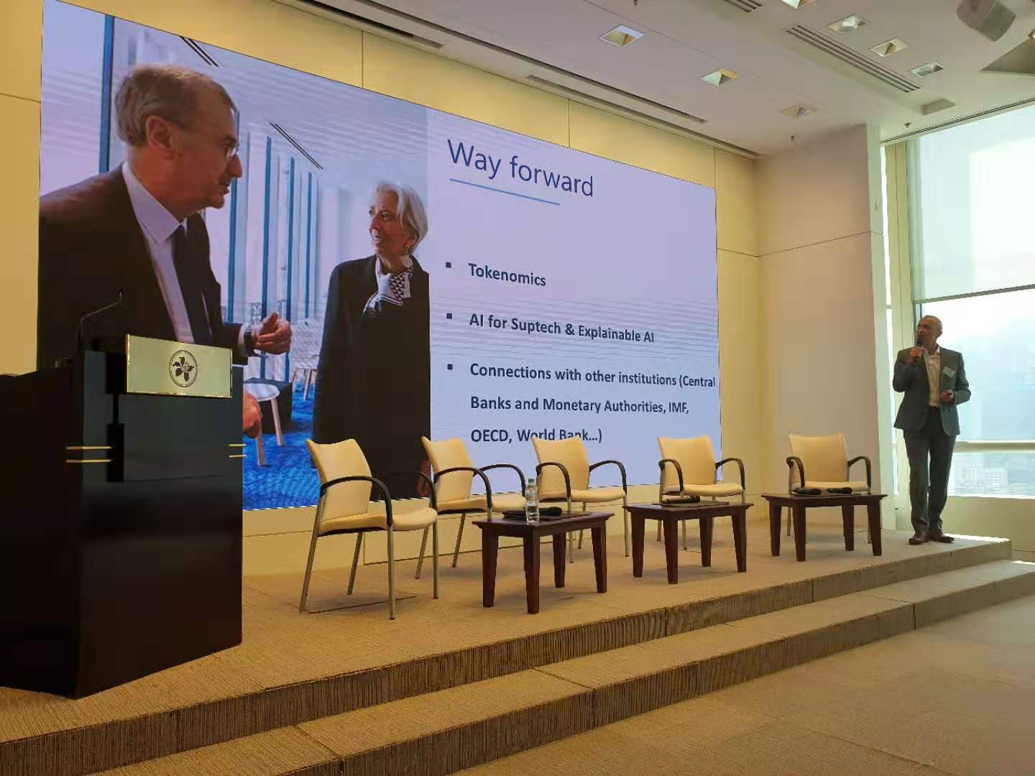
The Central Banker of France Talking about Tokenomics

Slide 5
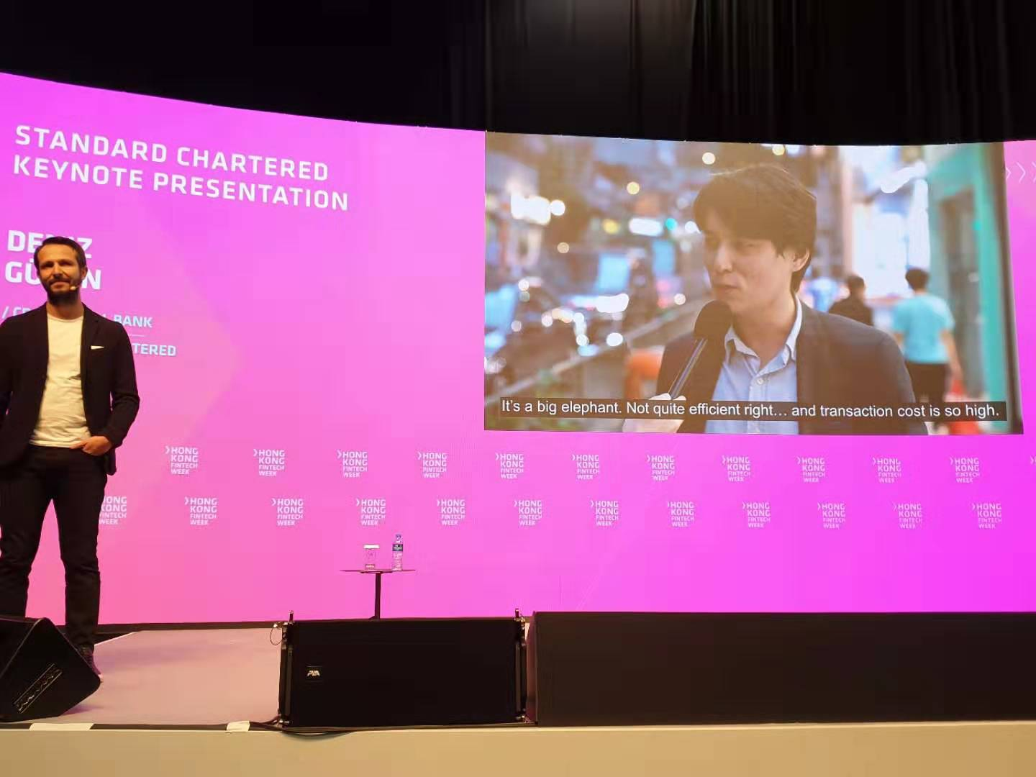
Standard Chartered VB CEO:
Interviewing People on “What Animal is Their Bank?”

Slide 6

Switzerland Issuing Crypto Banking Licenses

Slide 7
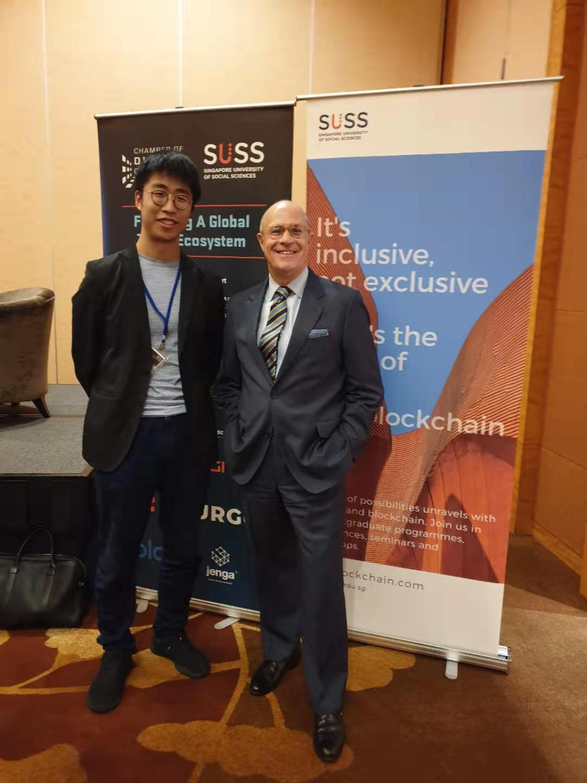
The Former Chairman of US CFTC (who ruled Bitcoin and Ethereum were commodities) thinking about a Digital Dollar…

Slide 8
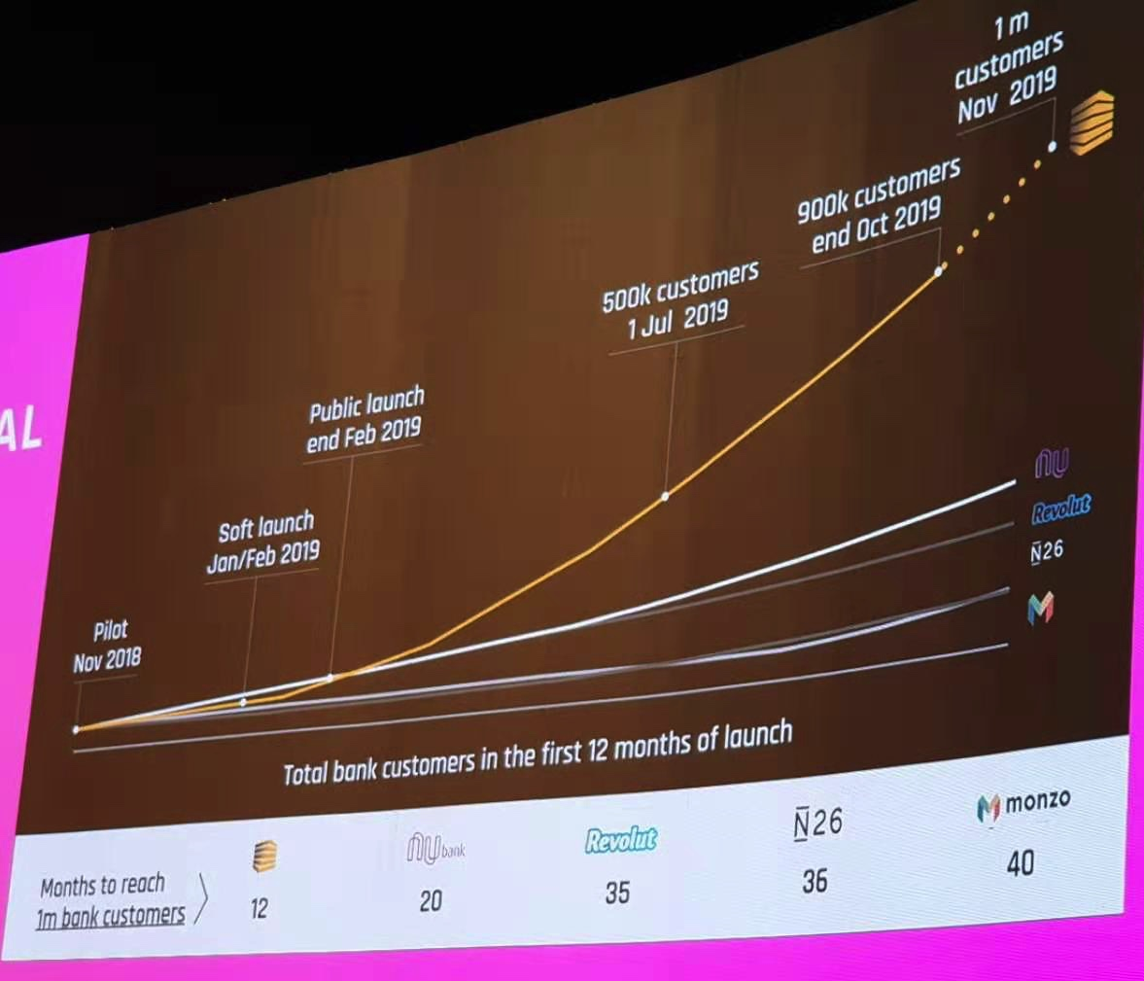
An African Startup Growing Faster Than European Unicorns

Slide 9
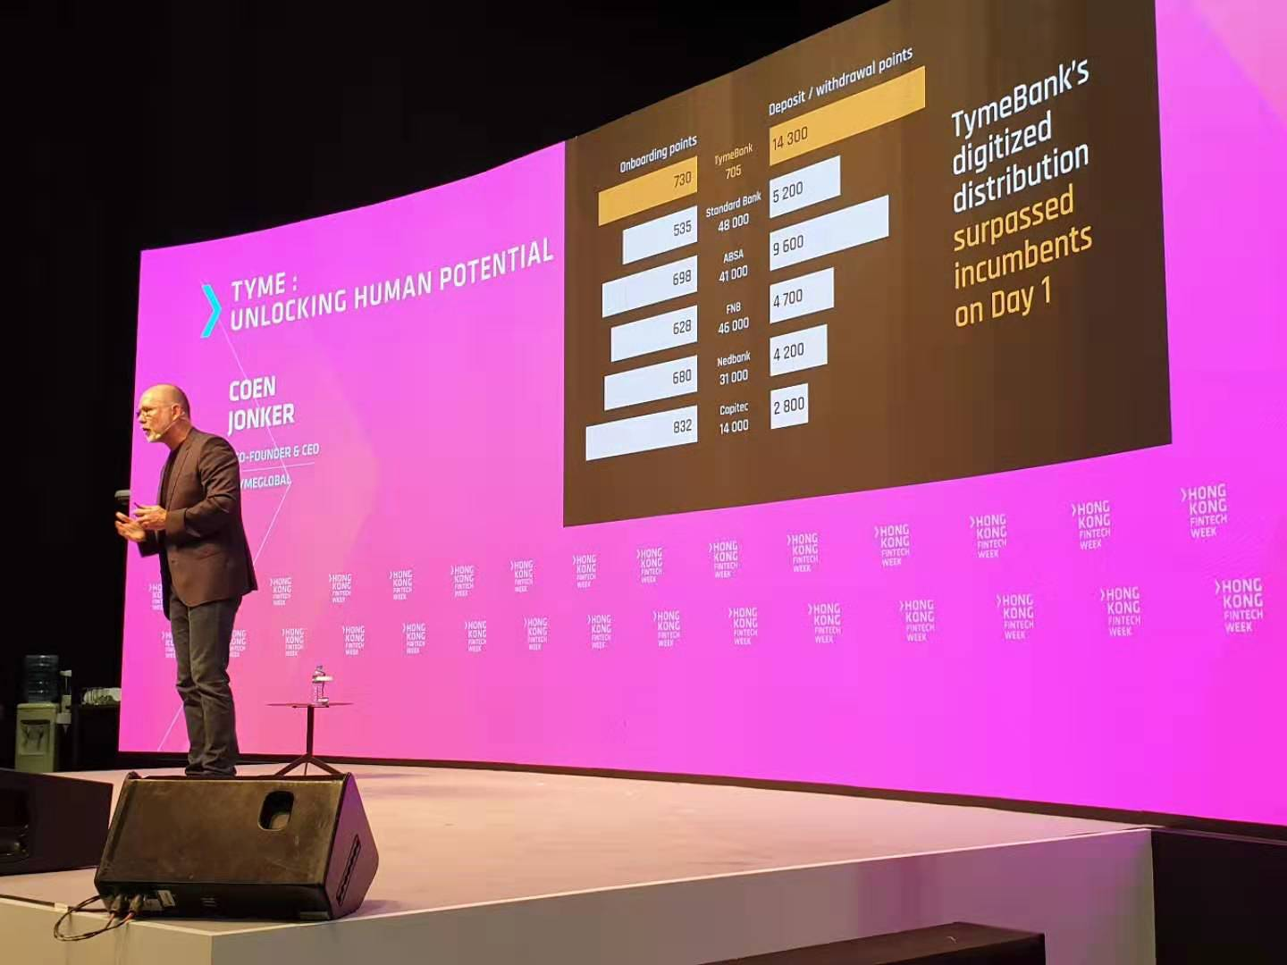
… exceeding the customer experience with < 5% of their staff

Slide 10
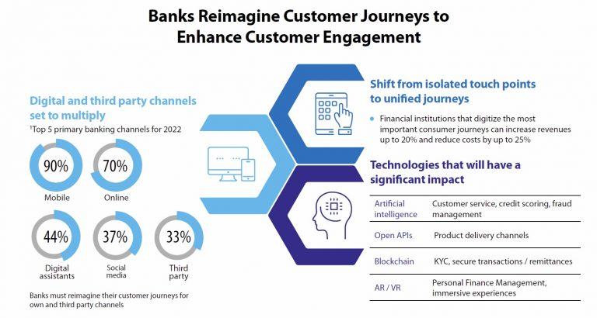

Slide 11
6 Drivers of Digital Finance
The Creation of Money – Mining and Maker
Online Banking – Virtual Banks and Lending Platforms
Managing Identity – Getting Past KYC/AML
Moving Transactions at the Speed of Light
Breaking Down Data Silos – “Open Banking 2018”
Building a Connected Global Economy – What Else Can We Trade?

Slide 12
Stay Tuned for the Revolution

Slide 13

Contact us max@blockdynamics.io

